Slide 1
Troubleshooting Code

Slide 2
Programming Isn’t Easy
When you are writing code, you will inevitably run into a problem that seems unsolvable, or an error that seems untraceable. It is important that you be resourceful and try your best to solve the problem. You should also take preventative measures, such as thoroughly testing your code often.
“
If things aren’t breaking, the you’re not moving fast enough. People learn by making mistakes.
”
Mark Zuckerberg

Slide 3
The Steps to Troubleshoot
Debug Your Code
Use debuggers in your IDE to analyze your code. You may just have a typo or some other simple mistake, so it is important to look over your code before getting worried.
Read the Documentation
Solutions to many of your problems will be in the documentation for the platforms, frameworks, and languages you are using. Reading the documentation is an easy first step that many people miss.
Search the Internet
Search for your error on the internet. Stack Overflow is a forum that is helpful to many developers. If your code is raising an error, search for the error message.
Phone a Friend
If you are still struggling, reach out to a friend, mentor, or teammate who may have seen the problem before.

Slide 4
Troubleshooting Resources
Stack Overflow
Reddit- r\askprogramming, r\java, r\swift, etc.
Discord/Slack: check the internet for public Discords and Slack workspaces to join a developer community.

Slide 5
Troubleshooting Resources
Stack Overflow
Reddit- r\askprogramming, r\java, r\swift, etc.
Discord/Slack: check the internet for public Discords and Slack workspaces to join a developer community.

Slide 6
How to ask a Question on Stack Overflow
From Stack Overflow Help Blog

Slide 7
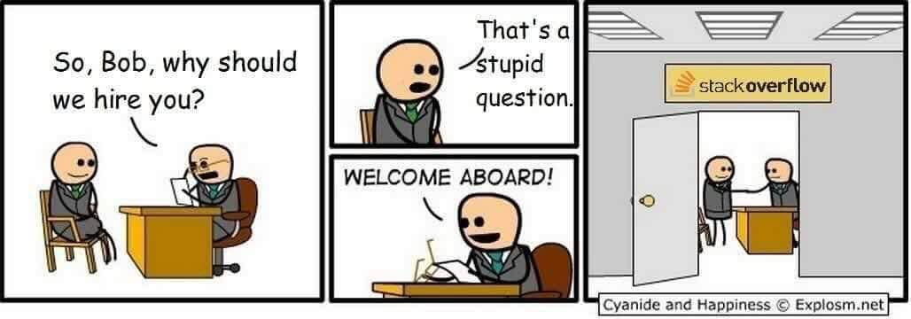
How to ask a Question on Stack Overflow
From Stack Overflow Help Blog
Source: Reddit

Slide 8
SEARCH FIRST!!
Write a title that summarizes the specific problem
Before posting it is critical that you search before you post. It is likely that your question has been answered before, so do your best to avoid posting a question that has already been asked.

Slide 9
Choosing a Title
Write a title that summarizes the specific problem
Bad: C# Math Confusion
Good: Why does using float instead of int give me different results when all of my inputs are integers?
Bad: [php] session doubt
Good: How can I redirect users to different pages based on session data in PHP?
Bad: android if else problems
Good: Why does str == "value" evaluate to false when str is set to "value"?

Slide 10
Writing your Question
Help others reproduce the problem by providing code. Here are some guidelines:
Include just enough code to allow others to reproduce the problem. For help with this, read: How to create a Minimal, Complete, and Verifiable example.
If it is possible to create a live example of the problem that you can link to (for example, on http://sqlfiddle.com/ or http://jsbin.com/) then do so - but also copy the code into the question itself. Not everyone can access external sites, and the links may break over time. Use Stack Snippets to make a live demo of inline JavaScript / HTML / CSS.
DO NOT post images of code, data, error messages, etc. - copy or type the text into the question. Please reserve the use of images for diagrams or demonstrating rendering bugs, things that are impossible to describe accurately via text.

Slide 11
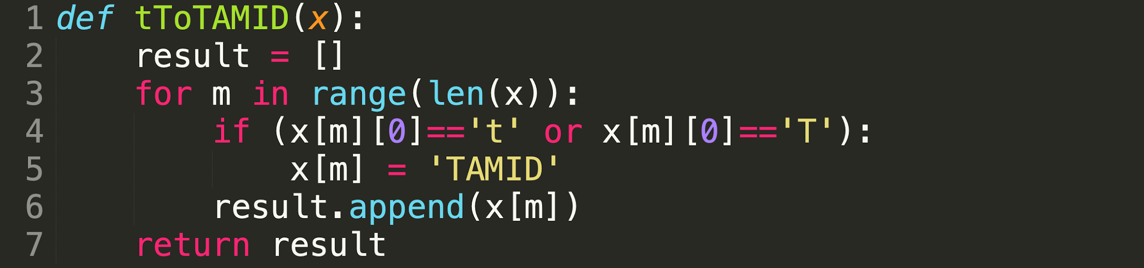
Debugging Exercise (Python)
tToTAMID takes in an array of strings x, and non-destructively returns an array with the same elements as x, but all strings that start with a ‘t’ or ‘T’ are switched with ‘TAMID’. Fix the function so it works properly (Java on next slide).

Slide 12
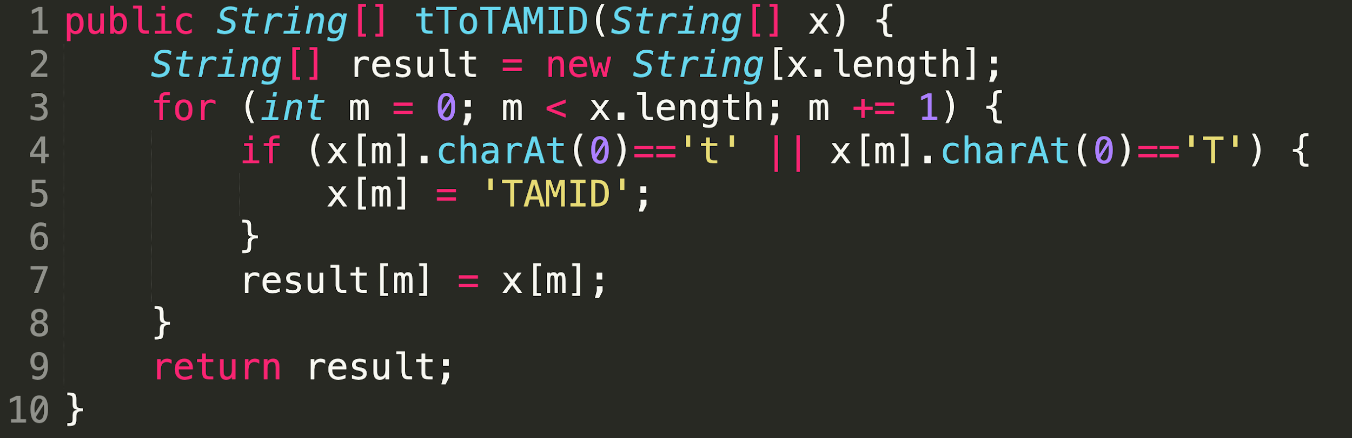
Debugging Exercise (Java)
tToTAMID takes in an array of strings x, and non-destructively returns an array with the same elements as x, but all strings that start with a ‘t’ or ‘T’ are switched with ‘TAMID’. Fix the function so it works properly.

Slide 13
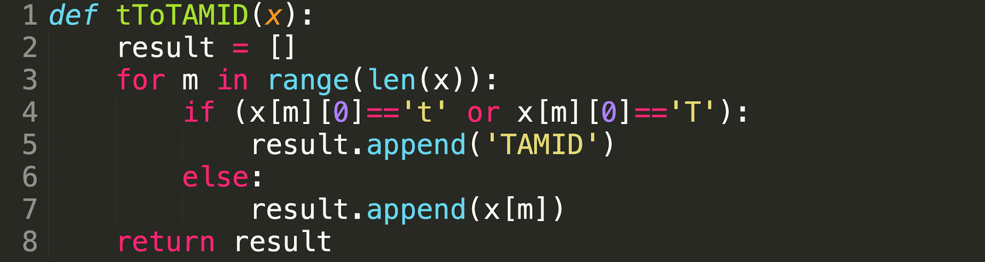
Solution: Python
tToTAMID is not supposed to alter the input, but the erroneous code did. Here is the solution:

Slide 14
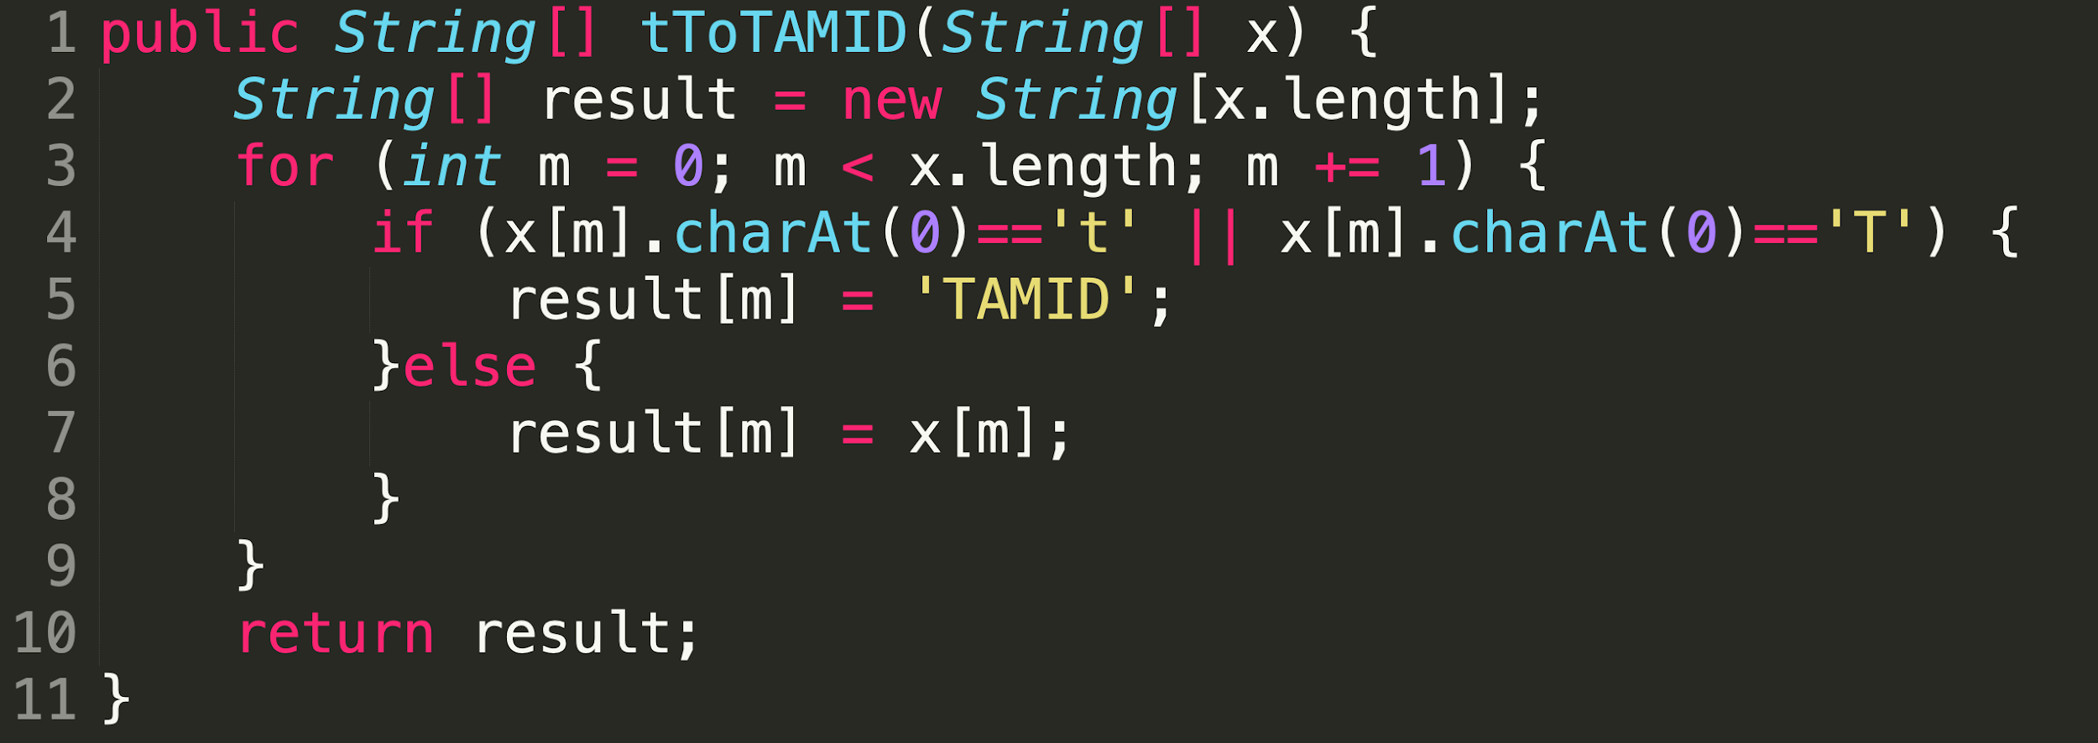
Solution: Java
tToTAMID is not supposed to alter the input, but the erroneous code did. Here is the solution:

